Slide 1
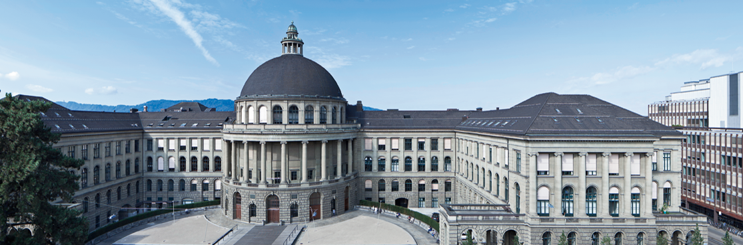
Joint 3D Scene Reconstruction and Class Segmentation
3D Vision – CVG – ETH Zurich
Instructors: Prof. Marc Pollefeys, Dr. Torsten Sattler
Teaching Assistant: Yagiz Aksoy, Johnasses Schönberger, Thomas Schöps, Peidung Liu
Supervisors: Martin Oswald, Pablo Speciale
Students: Adrian Schneuwly, Johannes Oswald, Tobias Grundmann

Slide 2
Overview
Problem & Motivation
Introduction & Related Work
Method
Mathematical Formulation
The Ray Likelihood and Its Approximation
Training the Priors
Experiments & Conclusion

Slide 3
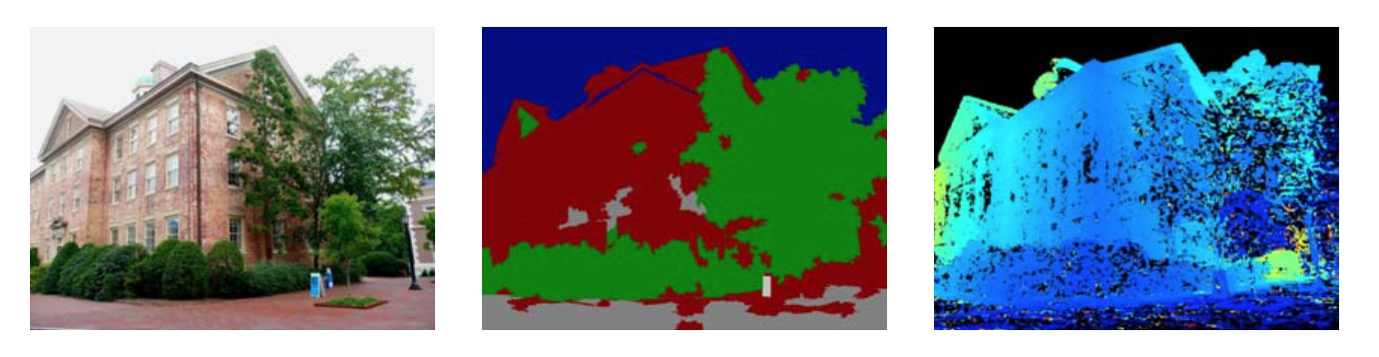
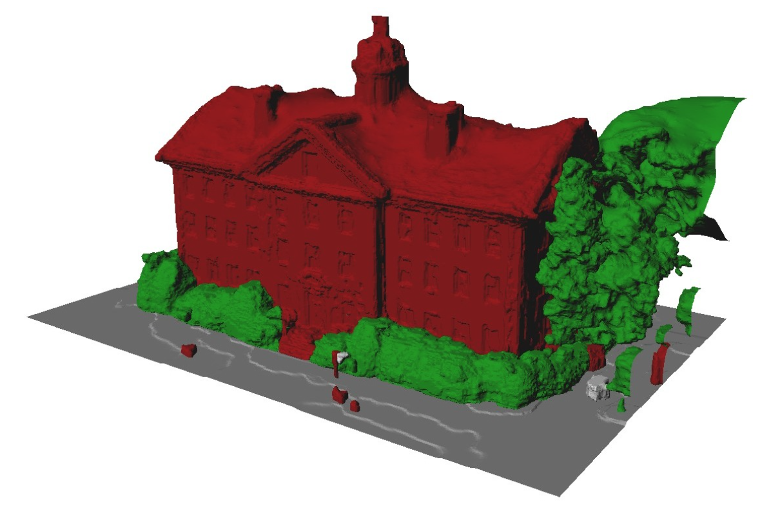
Problem & Motivation
Both ill-posed problems:
Image segmentation
Dense 3D modeling
Solution: Regularizers, but it often fails
Papers approach:
Joint segmentation and dense reconstruction
Why does this makes sense?
Image segmentations
-> cues about surface orientation
Dense 3D reconstruction
-> yields a suitable regularization for segmentation
Input Image
Classification
Depthmap
Result: Accurately labeled 3D reconstruction
Source: Hane_Joint_3D_Scene_2013_CVPR_paper

Slide 4
Introduction & Related Work
TODO: Was am beten hier rein? Oder sogar weg?

Slide 5
Method: Mathematical Formulation
Continuous Formulation
TODO: Verstehen und machen oder weglassen?
?

Slide 6
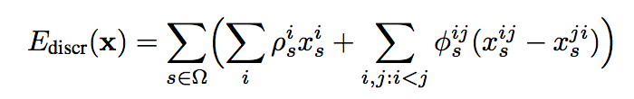
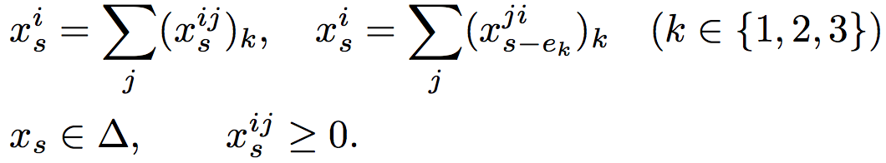
Method: Mathematical Formulation
Discretized Formulation
Goal: Assine label (free or occupied) to each location in finite voxel grid
to do so minimize the convex Energy
subject to the following marginalization, normalization and non-negativity constraints
What does that mean?

Slide 7
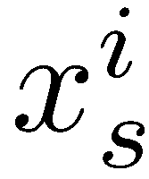
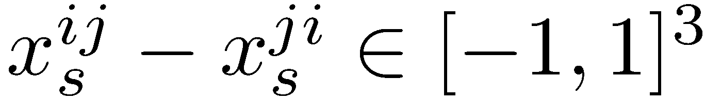
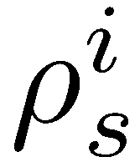

Method: Mathematical Formulation
Discretized Formulation: Interpretation
encodes whether label i is assigned at voxel s
represents the local surface orientation if it is non-zero
is the unary data term encoding the preference of voxel s for a particular label i
is the location and direction-dependent smoothness prior
Indicates local compatibility of boundary bewteen label i and j
Class-specific geometric priors
Modeled from training data

Slide 8
Method: Mathematical Formulation
Discretized Formulation: Interpretation
with
TODO: Interpretation von den Contraints

Slide 9
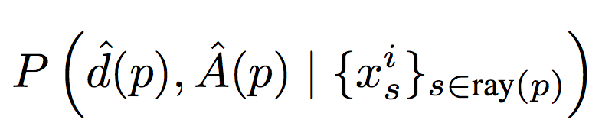
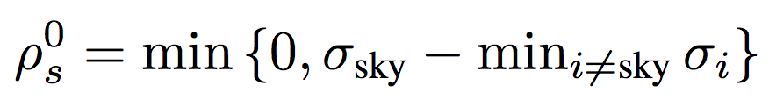
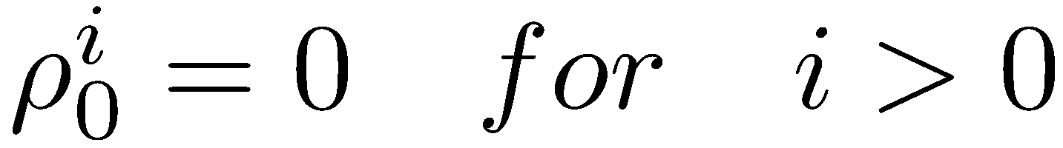
Method: Ray Likelihood and Its Approximation
Goal: Depth maps + appearance-based likelihoods -> unaries ρ
Unaries ρ are calculated along ray from pixel p
Our task: Model the likelihoods
Two cases:
Observed depth
Missing depth
Missing depth -> mostly occur in the sky regions.
We set for all voxels along ray(p)
Indicator function for label i and voxel s
Observed depth
Local image appearance in neighborhoods
Notes:
WAS IST sigma sky, nicht klar an der Stelle.

Slide 10
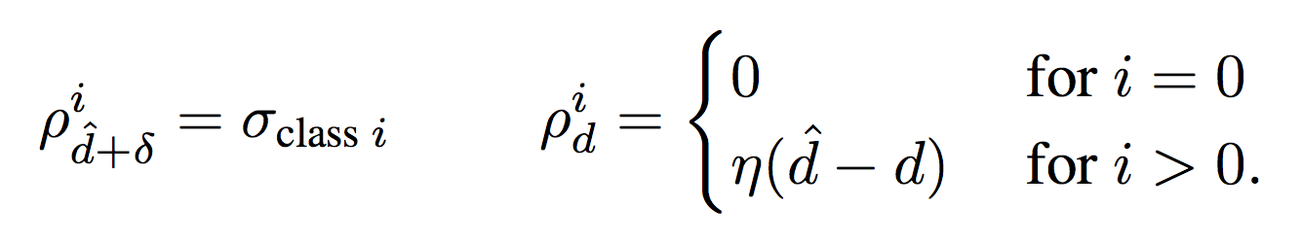
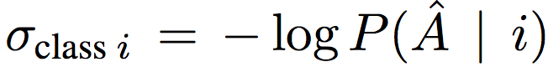
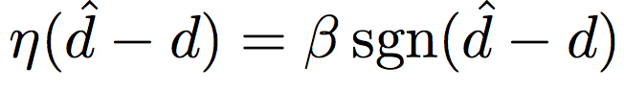
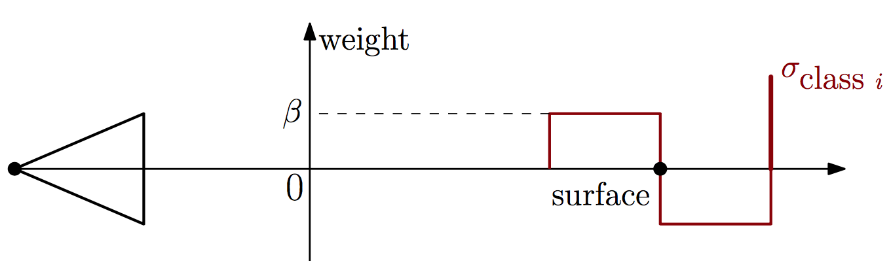
Method: Ray Likelihood and Its Approximation
Case: Observed depth
Assume that likelihoods factorizes into
Assume inlier noise is bounded δ, then
Result:
Confidence of trained appearance- based classifier for object category i
Noise of depth sensing process
Source: Hane_Joint_3D_Scene_2013_CVPR_paper

Slide 11
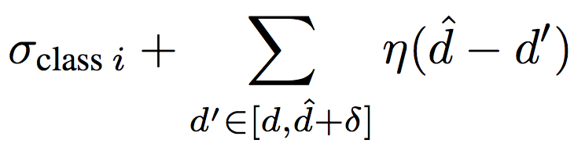

Method: Ray Likelihood and Its Approximation
3 Cases: Contribution of unary terms to the complete energy
Free-space transition to particular object class i at depth d:
Summing yields
All voxels in the range are freespace:
Contribution is just
All voxels in the range are assigned to object label i
Meaning: Transition 1 earlier along the ray
Source: Hane_Joint_3D_Scene_2013_CVPR_paper

Slide 12
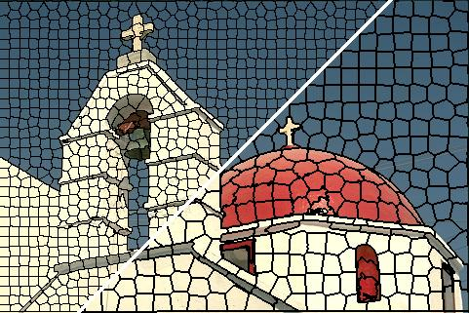
Method: Training the Priors
Appearance Likelihoods
Goal: classification scores for the
labels in the input images
We train a boosted decision tree classifier
Training images are segmented into super-pixels (mean shift)
225 dimensional feature vectors based on color, intensity, geometry, texture, location
Classifier is trained over 5 classes: sky, building, ground, vegetation, clutter
Result: Scores represent the log-likelihoods of each class for each region of the image
Super-pixels
Source: Achanta et al: SLIC Superpixels Compared to State-of-the-art Superpixel Methods
Notes:
What is this mean shift segmentation algorithm? http://stackoverflow.com/questions/4831813/image-segmentation-using-mean-shift-explained

Slide 13
Method: Training the Priors
Class-Specific Geometric Priors
?
TODO: Understand
Source: Achanta et al: SLIC Superpixels Compared to State-of-the-art Superpixel Methods
Notes:
What is this mean shift segmentation algorithm? http://stackoverflow.com/questions/4831813/image-segmentation-using-mean-shift-explained

Slide 14
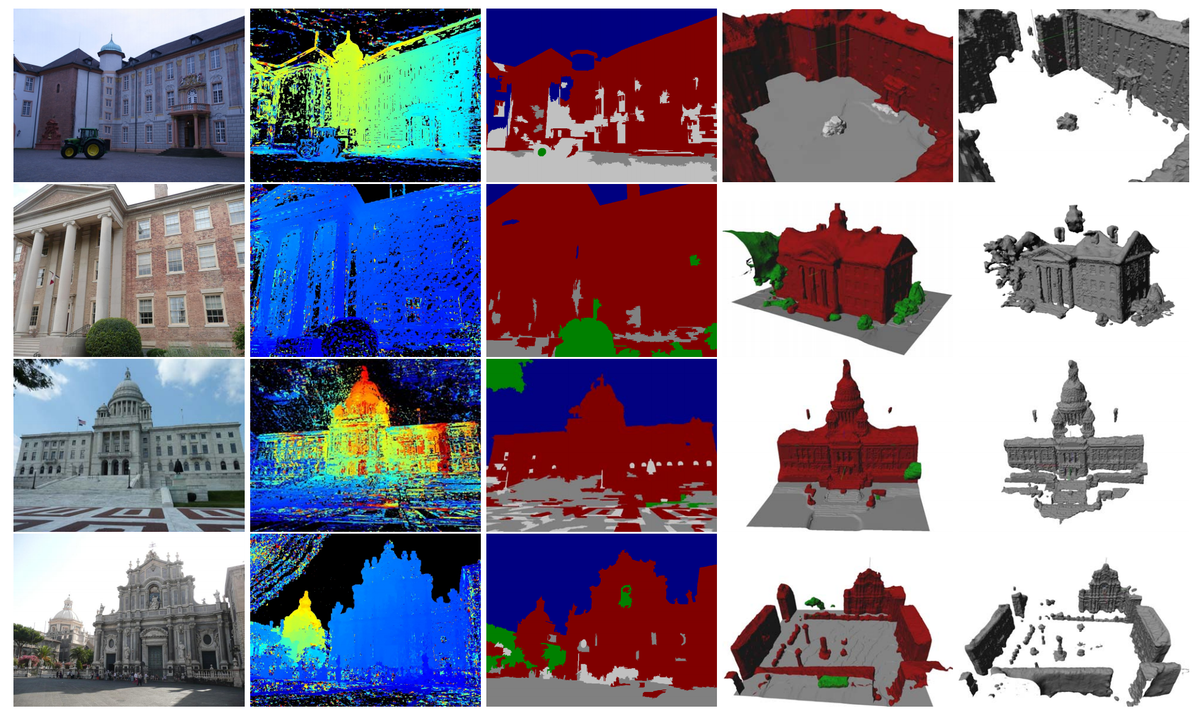
Experiments & Conclusion
The approach leads to more accurate geometry and image segmentation is improved (Col. 4)
Image & Depth map
Raw Image Labeling confuses:
Ground, building and clutter
TV-Flux (standard): Misses ground fully,
Particially facadas and roof structure
Source: Hane_Joint_3D_Scene_2013_CVPR_paper
Notes:
Foto ist auf der rechten Seite, damit wir zeigen können wo das Problem bei Tensorflow wo was wir jetzt durch Keras behoben haben.

Slide 15
Thank you!

